Slide 1

Predictive Maintenance for Smart Factories
A Data-Driven Approach to Forecasting Machine Failure
Dataset link- https://archive.ics.uci.edu/dataset/601/ai4i+2020+predictive+maintenance+dataset

Slide 2
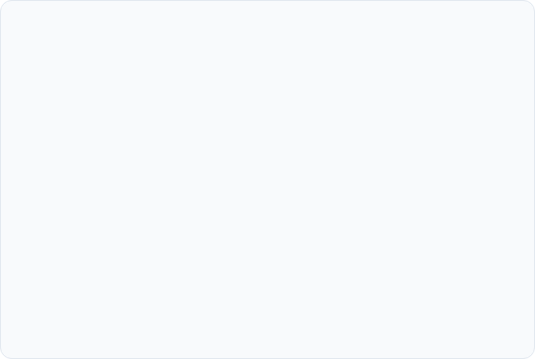

Business Problem & Case Study
The Business Problem
The Project Goal
Unplanned manufacturing downtime is a critical business challenge. Each hour a machine is unexpectedly offline leads to significant financial losses from:
This project uses the AI4I 2020 dataset as a case study to build a robust classification model. Goal: Proactively predict machine failure *before* it occurs by analyzing real-time sensor data. Impact: Enable proactive maintenance, reduce costs, and improve operational safety.
Lost productivity and missed deadlines.
High costs for emergency repairs.
Wasted raw materials.
Potential safety hazards for operators.

Slide 3


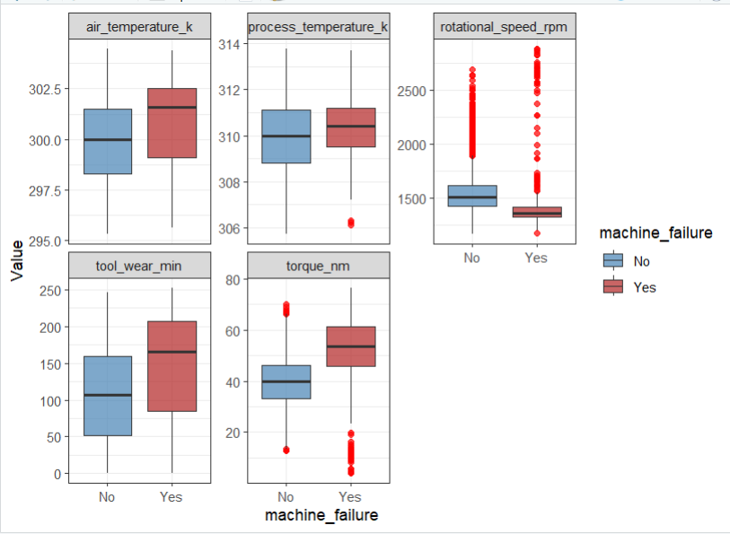
Outlier Analysis
Key Findings from Boxplots
Strategic Decision: Retain Outliers
Initial Exploratory Data Analysis (EDA) using boxplots revealed significant "outliers," particularly in sensor readings for:
These are not data errors to be removed. In the context of predictive maintenance, these extreme values are the most critical predictive signals.
Torque [Nm]
Tool Wear [min]
A sudden spike in torque or a high tool wear value is precisely what indicates an impending failure. Removing them would remove the very problem we are trying to predict.
Rotational Speed [rpm]

Slide 4
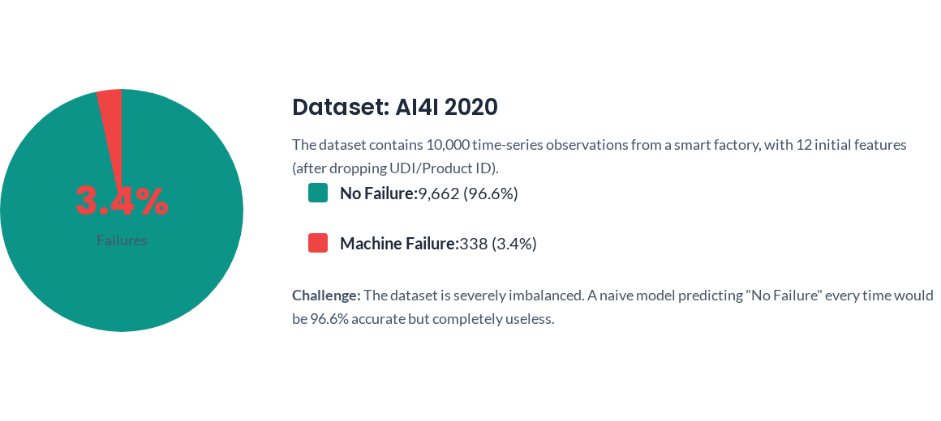
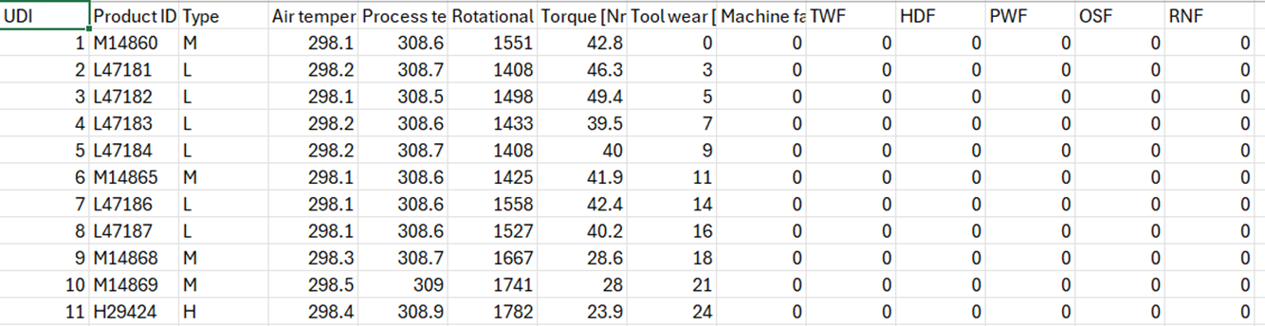
Dataset Overview

Slide 5
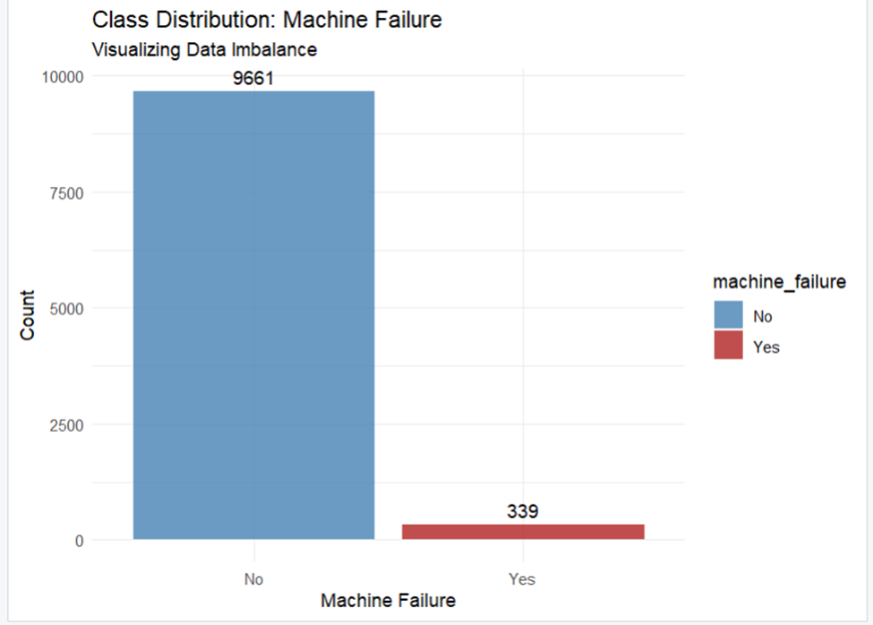
Class Imbalance

Slide 6
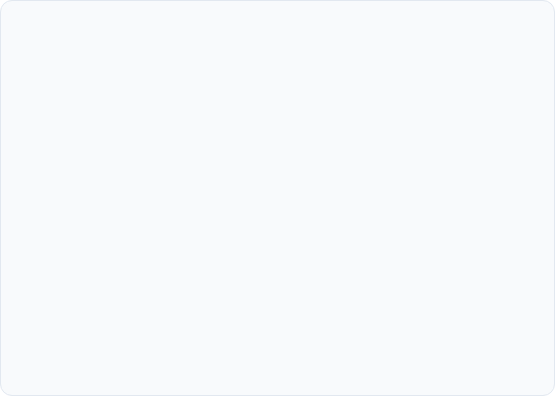
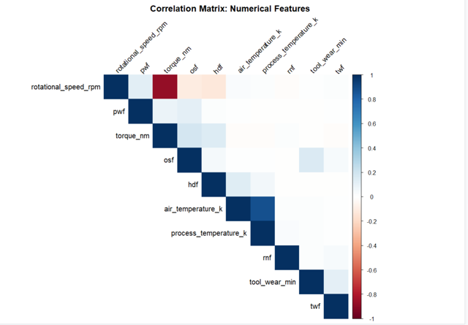
Correlation & Feature Selection
A heatmap was generated to visualize the relationships between all numerical features. This helped identify multicollinearity and, more importantly, data leakage.
Identifying Data Leakage
The original dataset included five binary flags:
Tool Wear Failure (TWF)
Heat Dissipation Failure (HDF)
Power Failure (PWF)
Overstrain Failure (OSF)
Random Failure (RNF)
These flags are post-failure indicators, not predictors. They are recorded a failure is identified.
Decision: Remove Leakage
All five failure-type flags were removed from the feature set to build a true predictive model that relies only on sensor data available before an event.

Slide 7


Modeling Setup: The Time-Series Split
Why Not a Random Split?
Our Approach: Time- Series Split
A standard `train_test_split` (randomly shuffling data) is incorrect for this problem. This data is a time-series log.
We must respect the chronological order of the data. A 70/30 time-ordered split was used:
Random shuffling would cause severe data leakage, where the model is "predicting the past" using data from the future. This results in an artificially high, unrealistic performance score that would fail in production.
Training Set: The first 70% of the data (Rows 1 - 7,000)
Testing Set: The final 30% of the data (Rows 7,001 - 10,000)
This method ensures our model is tested on truly unseen future data, just as it would be in a real-world deployment.

Slide 8





Feature Engineering & Creation
To provide more context to the models, we engineered new features from the raw sensor data and encoded categorical variables.
Power (kW)
Temp Difference (K)
Tool Wear Category
One-Hot Encoding
torque_nm * rotational_speed_rpm Measures the actual power output, combining two key sensors.
process_temp_k - air_temp_k Represents the heat generated by the machine's operation.
Binned `tool_wear_min` into categories (New, Moderate, Worn, Critical) to convert a linear feature into steps.
Converted the categorical 'Type' feature (L, M, H) into numerical binary flags for the models to understand.

Slide 9


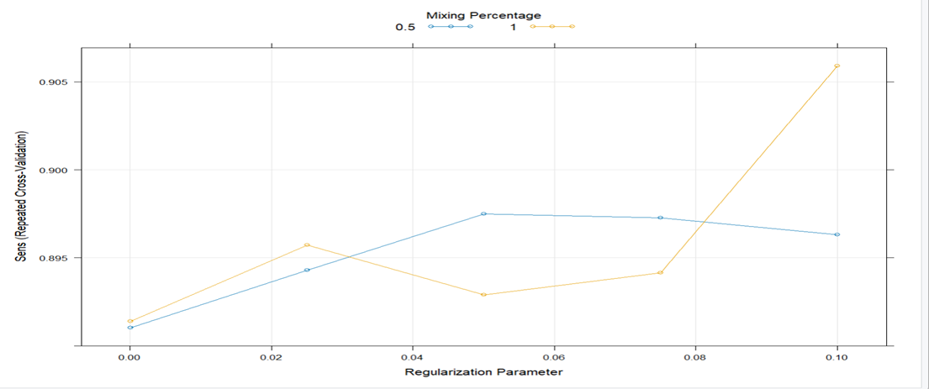
Handling Imbalance: SMOTE & Cross-Validation
The Problem
With only 3.4% failure cases, our training data is highly imbalanced. If the model learns from this naively, it will be heavily biased towards predicting "No Failure" and will miss the rare, important failure events.
The Solution: SMOTE in a CV-Loop
We use the Synthetic Minority Over-sampling TEchnique (SMOTE).
Crucial Step: SMOTE is applied inside a 5-fold cross-validation loop. This prevents data leakage by only generating synthetic "failure" examples within each training fold. The validation fold is always kept separate and contains only real, unseen data, giving a true measure of performance.

Slide 10
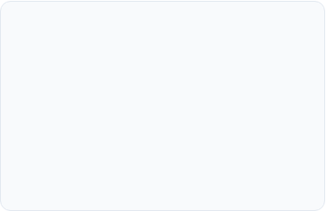
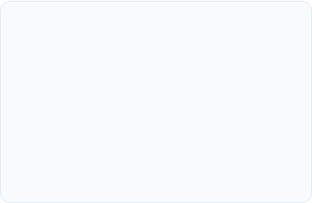
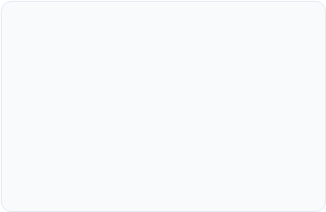



Models Trained
We trained three distinct classification models, all optimized for 'Sensitivity' (Recall). This focus ensures our primary goal is to correctly identify as many true failure events as possible.
Logistic Regression
Decision Tree
Random Forest
A robust and interpretable linear model. We used `glmnet` with regularization (Alpha=0.5, Lambda=0.0001) to prevent overfitting and select the most impactful features.
A simple, highly visual model. The tree was pruned using cross-validation (`cp=0.002`) to find the optimal set of rules and avoid overfitting to noise in the training data.
A powerful ensemble model using 500 trees (`ranger`). By combining the votes of many trees, it reduces variance and dramatically improves predictive accuracy and stability.

Slide 11
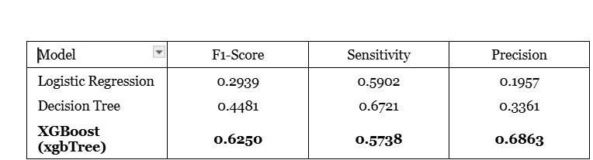
Model Performance Comparison (Test Set)
Key Takeaway: While all models were good at finding failures (high Recall/Sensitivity), the XGBOOST was far superior at being correct when it did (highest Precision and F1-Score), leading to more accurate alarms.

Slide 12
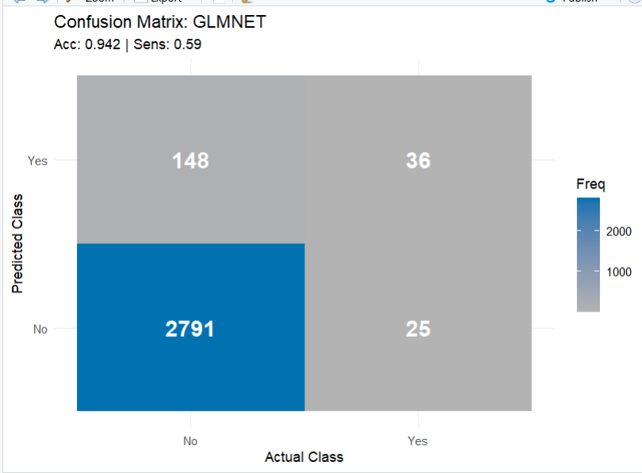
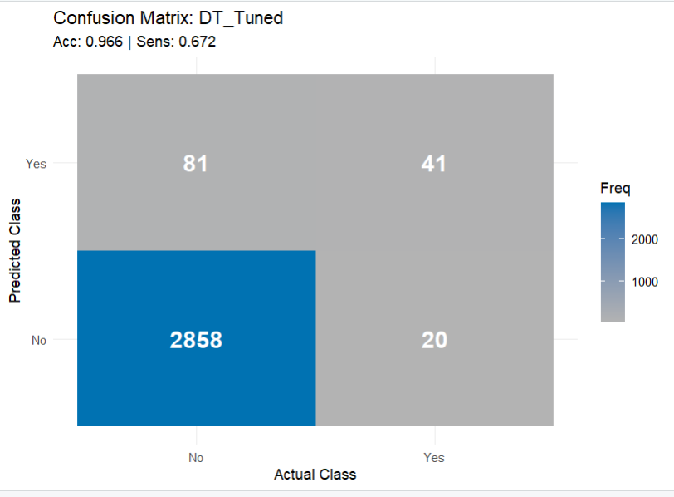
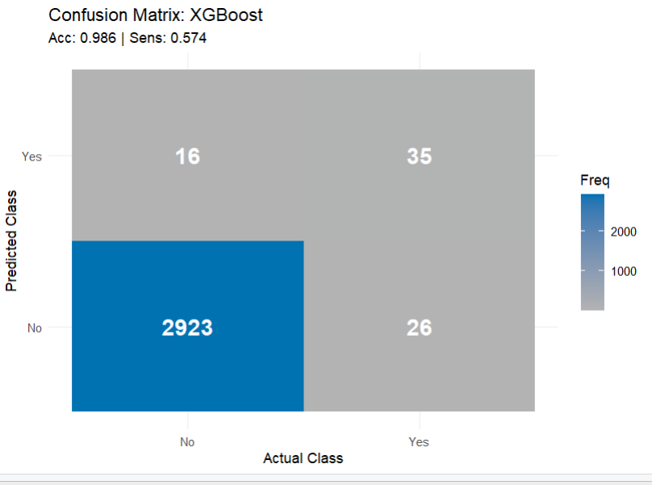
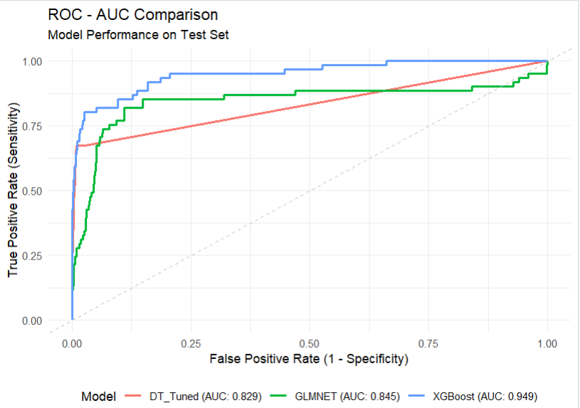
Confusion Matrix And ROC-AUC of The 3 Models

Slide 13
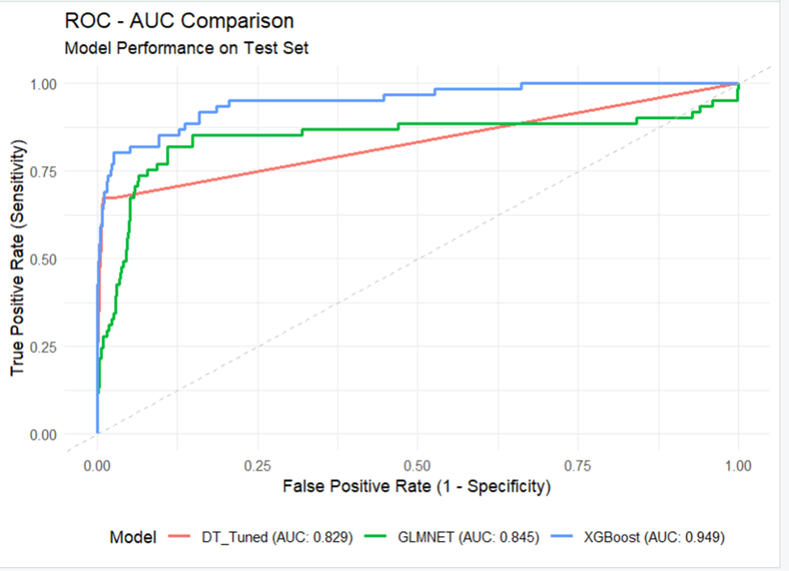
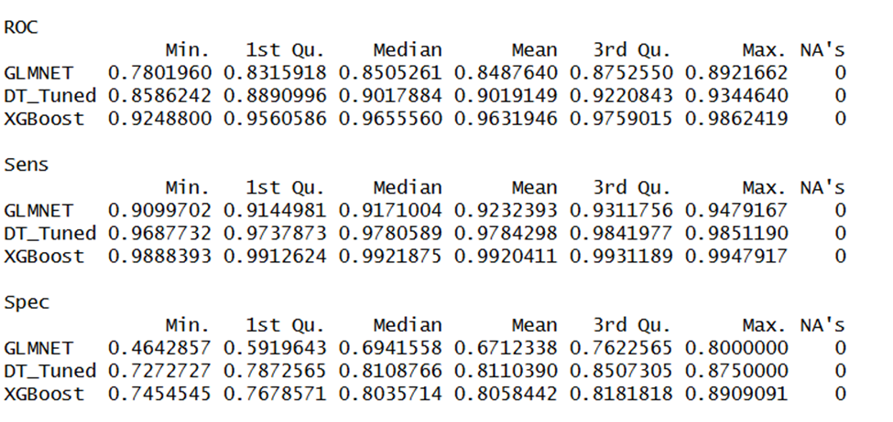
ROC - AUC Comparison

Slide 14
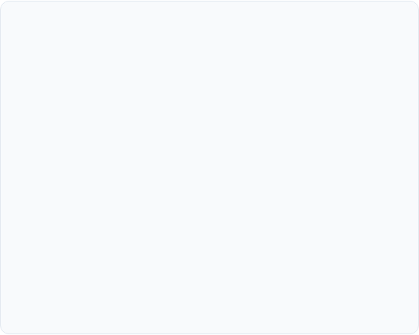

Best Model: XGBOOST, change
Why XGBOOST?
Top Predictive Features
The XGBOOST model is the clear winner for the business problem.
The top drivers of failure are:
1. Highest F1-Score (0.625)
The F1-score is the golden metric for imbalanced data. It balances precision and recall, preventing both false alarms and missed failures. XGBoost's 0.625 is 40% better than Decision Tree (0.448) and 112% better than GLMNET (0.294).
Torque [Nm]
Rotational Speed [rpm]
2. Best Precision (0.6863)
This means 68.6% of machines XGBoost flags as "at-risk" will actually fail. This is crucial for:
Reducing wasted inspection costs
Building maintenance team trust in the system
Avoiding alert fatigue
Power (kW) (Engineered)
Temp Difference (K) (Engineered)
Tool Wear Category (Engineered)
3. Solid Sensitivity (0.5738)
While slightly lower than DT (0.672), XGBoost catches 57% of actual failures while maintaining high precision. Decision Tree catches more failures but at the cost of triple the false alarms (precision: 0.336).

Slide 15

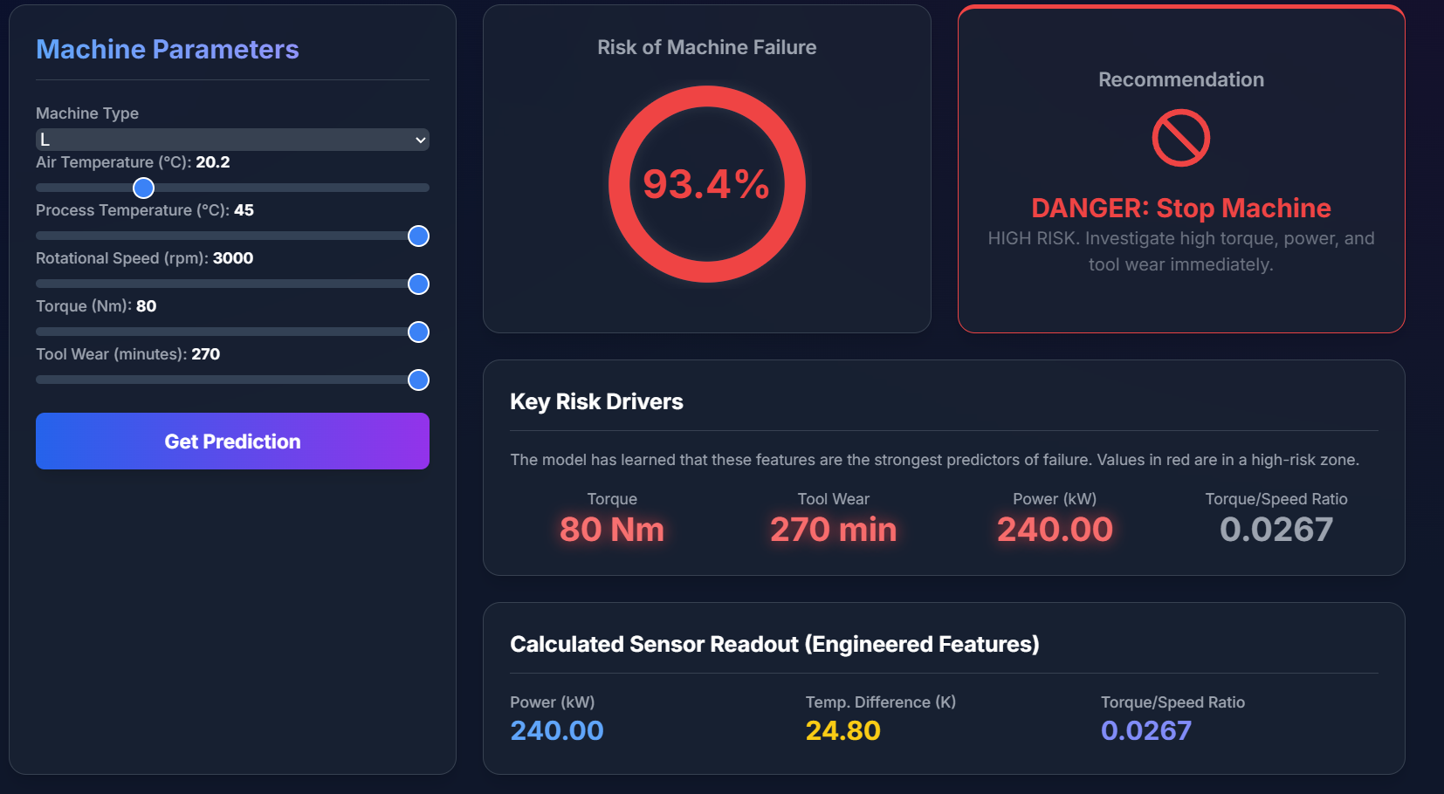
Project Deployment: Interactive Dashboard
Making the Model Accessible
A predictive model is only useful if it can be easily used by operators and managers on the factory floor.
We designed a prototype web dashboard that connects to the live model.
Allows for real-time input of sensor data.
Generates an instant failure-risk probability.
Provides a clear, actionable alert: "Normal Operation" or "Failure Risk Detected".
Highlights the key sensor readings that are contributing to a high-risk prediction.

Slide 16
Questions?
Thank you for your time.

